Slide 1

Building Capacity for a career in Tech through Games
Leanne Chukoskie, Ph.D.,
Associate Professor,
Northeastern University

Slide 2


Playing video games using your eyes
Eye tracker

Slide 3
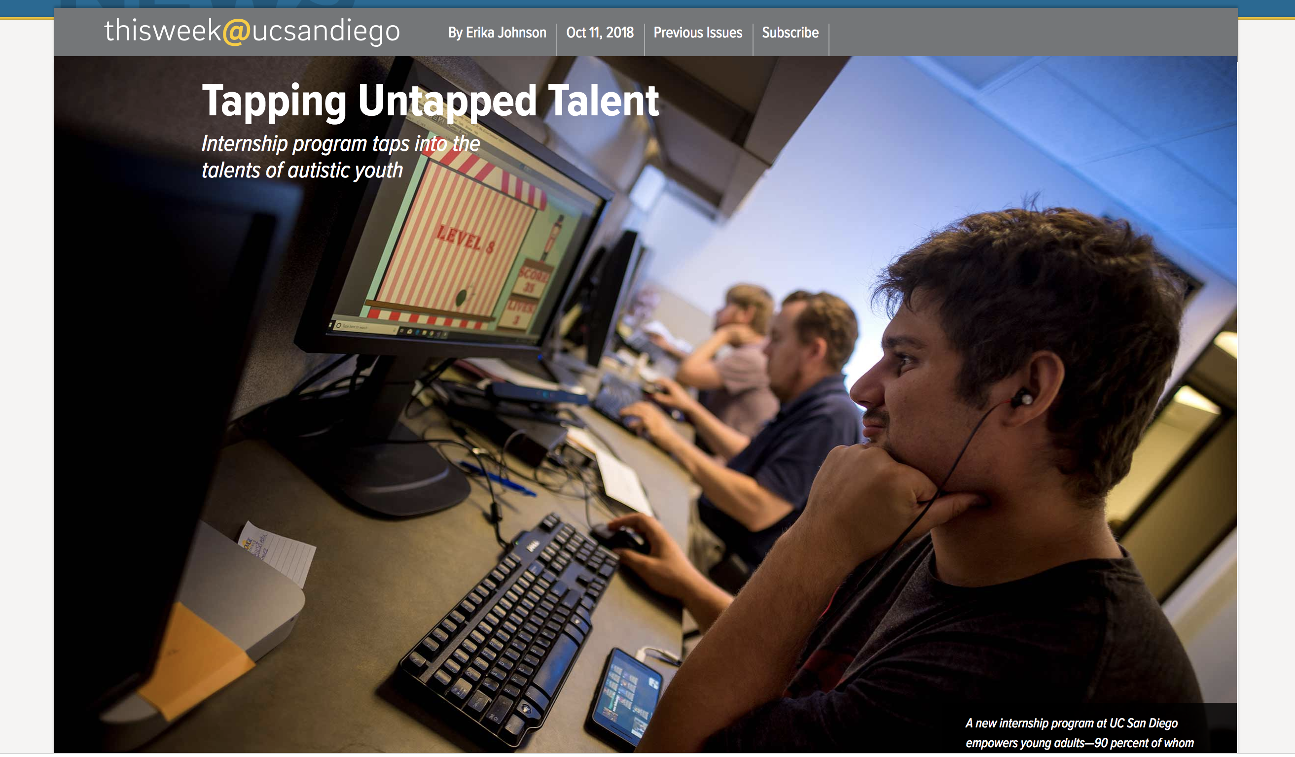

Slide 4
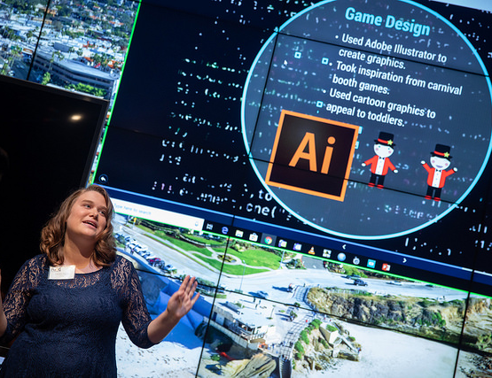
Building an ecosystem of Support:
Internships for Autistic adults
The Need
Training that focuses on durable hard skills for tech jobs
Also support soft skills needed for employment

Slide 6

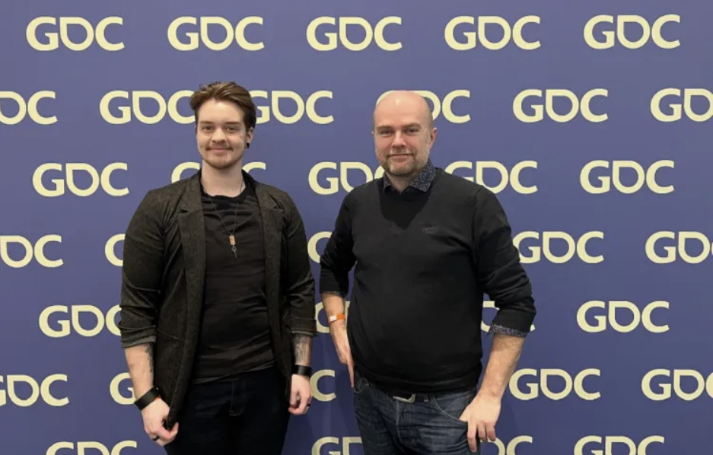
Careers in Games
Ubisoft neurodiversity talent program
Director, Pierre Escaich, (right) and
Aris Bricker (left) formerly of Redstorm
Presented at the 2023 Game Developer’s
Conference on the need for neurodivergent
Talent in games.

Slide 7

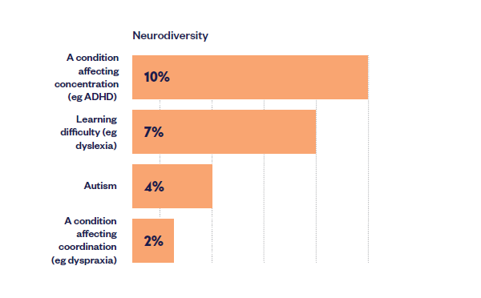
18% of UK Games industry employees
identify as Neurodivergent.

Slide 8
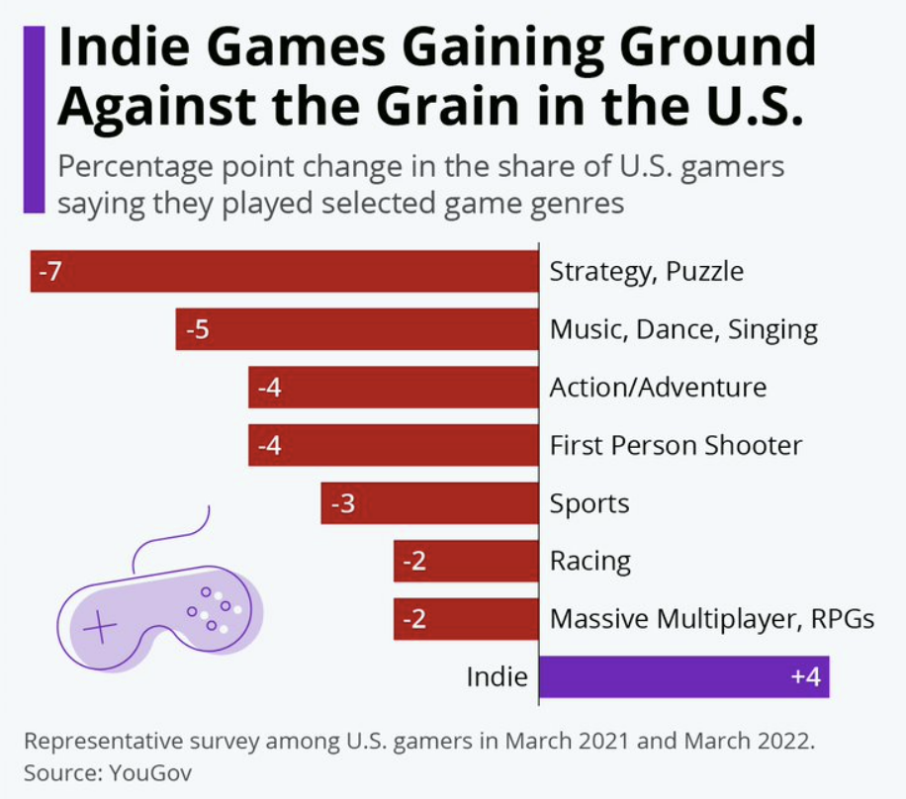
Jobs in Indie game and
“Serious Game” companies are easier to break into.
Often opportunities associated with universities
Internships are one way to gain skills
Apprenticeships are better, but few

Slide 9

entry level jobs in Games:
Quality Assurance tester
Game review writer (journalist)
Community manager
Jr. Game Developer
Front- or Back-end software engineer
Sound designer
Game Artist
Animator

