Slide 1
IDENTIFYING AUTISM IN GIRLS AND WOMEN
Notes:
This wasn’t supposed to be in honor of international women’s month. That’s just a coincidence. But let’s lean into it.

Slide 2


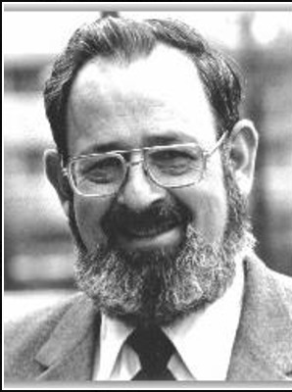
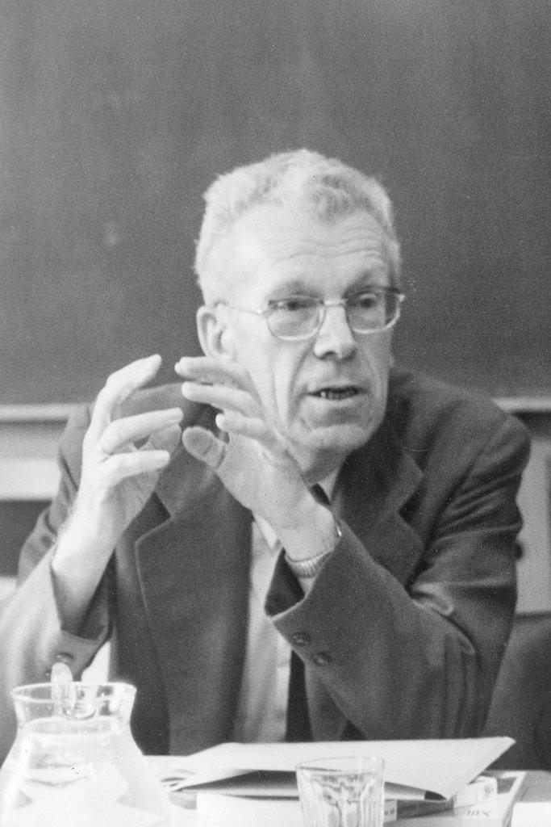


AN OLD BOYS’ CLUB
Notes:
A selection of some of the most influential voices throughout the history of autism as a diagnostic category, clockwise from left: Hans Asperger, Leo Kanner, Bruno Bettelheim, Bernard Rimland, Ole Lovaas, and Simon Baron-Cohen. You can probably name a lot of important figures who are missing from this pantheon. I invite you to shout out the names of those you like.

Slide 3
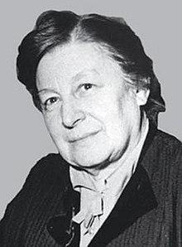
GRUNYA SUKHAREVA: FOREMOTHER OF AUTISM SCHOLARSHIP
Russian child psychiatrist
Identified and described autistic children over a decade before Asperger and Kanner
Studied boys and girls and documented gender differences
Published in German
Never cited by Asperger or Kanner, who were both native speakers of German
Work on autistic girls translated and published in English in 2020, bearing resemblance to modern understanding
Notes:
Sukhareva described the children as autistic but officially used terminology borrowed from Bleuler’s schemata, calling it “schizoid psychopathy,” which at the time just meant that they were eccentric to the point of psychological difference
To be frank, while scholarly and professional understandings of the contrasting manifestations of autism in boys and girls have progressed somewhat since the 1940s, they demonstrate little meaningful advancement relative to Sukhareva’s 94-year-old report. Perhaps if her work had been recognized and made available for researchers to consult from the beginning, we could have skipped almost a century of near-exclusively male-focused autism scholarship. But then, I would not have gotten to do this project.

Slide 4
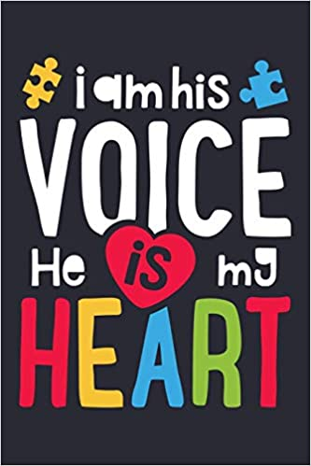
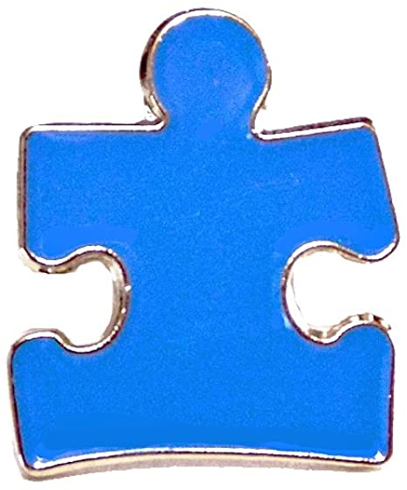
LIGHT IT UP BLUE
95% of the children at Asperger’s clinic were boys (Hippler & Klicpera, 2003)
8/11 of the children Kanner studied were boys (Kanner, 1943)
Modern diagnostic tools were designed and calibrated using a predominantly male sample (van Wijngaarden-Cremers, 2014)
Four boys are diagnosed with autism for every one girl (CDC, 2020)
This ratio is estimated as 10:1 for those without co-occurring intellectual disability (Attwood, 2006; Dworzynski, 2012)
Notes:
I apologize for the cringeworthy image on the right, but this is a rallying cry of Autism Warrior Parents that just assumes autistic children are boys
4:1 is likely high: by age 8 nearly 2% of children are diagnosed with autism, and about 81% of them are boys. but what about people diagnosed after age 8? girls tend to be diagnosed later.
10:1 is artificially high because there’s a cohort missing from the data: autistic girls without ID whose presentations are subtler so they evade diagnosis

Slide 5
REFERRAL BIAS
Parents and professionals conceive of autism as a boys’ condition
Adults only seek evaluation if a child’s behavior is significantly disruptive
Boys tend to externalize while girls tend to internalize, such that it’s usually more obvious when boys are in distress than when girls are (e.g., Attwood, 2006)
Girls are conditioned by their environments to behave more passively and use language more to express themselves (Cook et al., 2018)
Notes:
one reason for these inflated statistics comes from bias at the referral level: boys are being referred for evaluation more often than girls in a way that is not reflective of true incidence.
boys are more likely to act out, hit, etc., whereas girls are more likely to clam up, withdraw, hide, and stop engaging.
girls are feeling the same overwhelm, dysregulation, and distress as boys, but their expression is less obvious and less disruptive so parents and teachers are less likely to think of it as a real issue.

Slide 6
INSTRUMENT BIAS
ADOS and ADI-R were designed based on male subjects and calibrated using mostly male children (van Wijngaarden-Cremers et al., 2014)
Autism spectrum quotient (AQ) shows females at the extreme positions of the scale (either profoundly affected or not affected at all) which leads to a much higher cut-off score: females must show higher levels of autism to meet the criteria for the same autism label (Abu-Akel et al., 2019)
Notes:
An additional complication is that since so few autistic girls are included in studies about autism, it is very hard to come to any generalizable findings with such low statistical power. Either girls aren’t included at all and there’s nothing, or we get two or three girls, and with an N that low it is impossible to get any significant results unless the effect size is gargantuan. Low-N research is going to have lots of null findings and some extreme findings but is not sensitive to more moderate effect sizes, whereas studies on boys tend to pick up a range of effect sizes.

Slide 7

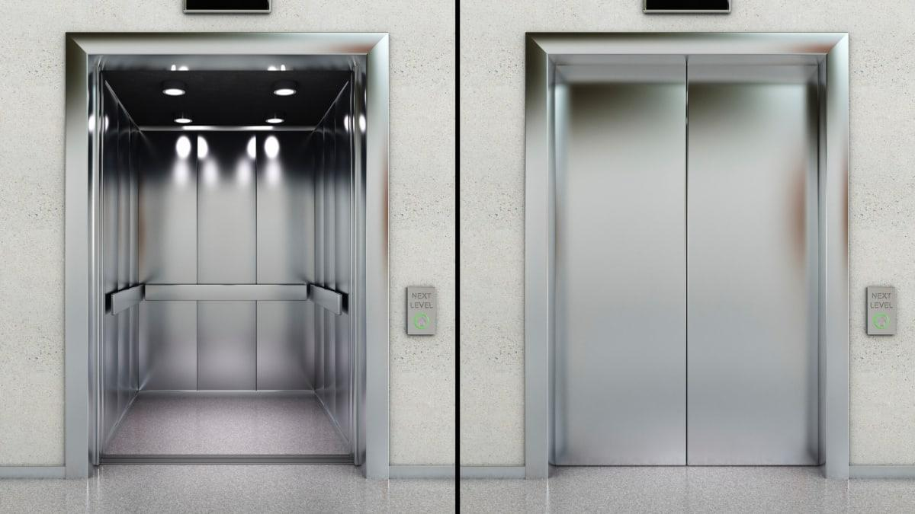
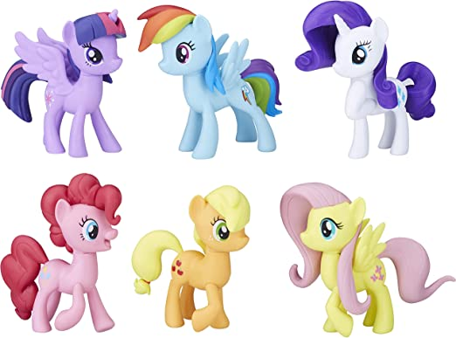

SPECIAL INTEREST AREAS
Boys’ special interests are often stereotypical and transportation-related (Hiller et al., 2016; Winter-Messiers, 2007)
Trains (often Thomas the Tank Engine)
Elevators
Cars
Airplanes
Girls’ special interests generally don’t differ topically from the casual hobbies of other girls (Sutherland et al., 2017)
Arts and crafts
My Little Pony
A favorite book series
Notes:
If your son knows and recites all the facts and stats about the elevators in your apartment complex, you might take that as a sign that he could be autistic. If your daughter knows and recites all the names and biographical information about even the most obscure mares in Ponyville and Canterlot, it might not seem so odd when all the other little girls love the series and babble on about it, too. Autistic boys’ special interests differ in salience rather than intensity, so boys who can’t stop talking about Thomas get fast-tracked for a diagnosis and girls who can’t put down Little House on the Prairie are just called bookworms.

Slide 8
SOCIAL-EMOTIONAL FACTORS
Boys are seen as “predatory” whereas girls are seen as “maternal” (Attwood, 2003)
Obvious, physical bullying versus subtle, indirect, exclusionary bullying (Cook et al., 2018)
Girls’ relationships are more demanding than boys’ (Tierney et al., 2016)
Girls especially rely on masking/camouflaging (Hull et al., 2016)
Notes:
As I mentioned earlier, girls already need to display more extreme traits just to register on the same scales that identify boys as autistic. This is compounded when we see how their social struggles are necessarily subtler. This is further amplified when we take masking/camouflaging into account.

Slide 9
MASKING/CAMOUFLAGING
Imitating the mannerisms of individuals who are socially successful (real or fictional)
Trying to fit in by acting “normal”
Actively suppressing autistic behavior, such as stimming and info-dumping
This is very draining and can have devastating long-term psychological consequences.
Notes:
In Tierney et al.’s (2016) study, 8/10 of the girls reported mental health struggles stemming from masking, five of whom reported self-injury or suicidality, and one of whom was hospitalized for months

Slide 10
MENTAL HEALTH CONCERNS
Autistic people are disproportionately exposed to risk factors for developing or exacerbating mental illness over time
Chronic sensory dysregulation
Loneliness/isolation
Difficulty adjusting to life transitions
Being different from most other people (neurominority)
Trying to contend with a society that can be hostile and antagonizing
An estimated 70% of autistic children have at least one co-occurring mental health problem (Simonoff, 2008)
Having these struggles and not understanding why creates a cycle of distress that is especially difficult for the undiagnosed
Notes:
Autism itself is not a mental illness.

Slide 11
PSYCHIATRIC DISTURBANCE
Autistic people with diagnoses are already more likely to have depression, anxiety, or bipolar disorder (Kirsch et al., 2020)
Diagnosed autistics without intellectual disability are more likely to struggle with addiction (Butwicka et al., 2017)
Diagnosed autistics are more likely to have restrictive eating disorders (Brede et al., 2020)
For around 80% of autistic women described by Brown et al. (2019), diagnosis of a mood disorder or eating disorder preceded an autism diagnosis by an average of 13 years
Notes:
Brown et al. (2019) explain this is ”diagnostic overshadowing”: features of psychiatric disorders obfuscate autistic traits and clinicians don’t see them and don’t know to look for them. This can prevent people from getting much needed support, and the consequences can be deadly.

Slide 12
SUICIDE RISK
Cassidy et al. (2014) found that nearly four times as many recently-diagnosed autistic adults had contemplated suicide as had NT adults, and that half of them had planned or even attempted it
Even after controlling for other factors, such as depression and isolation, just being autistic was deemed a significant predictor of suicidality (2014), as was masking/camouflaging (Cassidy et al., 2018)
The odds of dying by suicide are 7.55 times as high for autistics as for non-autistics, and this odds ratio increases to 9.40 for autistics considered “high-functioning” (Hirvikoski et al., 2016)
For non-autistics, men’s odds are 70% higher than women’s; for autistics, women’s odds are 7% higher than men’s
Autistic women’s odds of dying by suicide are 13.05 times as high as non-autistic women’s
Notes:
Study participants all diagnosed in adulthood. In Cassidy et al.’s study, the adults in question had recently been diagnosed with AS. In Hirvikovski et al.’s, the adults had all been diagnosed as autistic, and an average time of about three years elapsed between the diagnosis and the suicide. So these high suicide rates are among those diagnosed later in life.

Slide 13
RECOMMENDATIONS
Parents and professionals need to expand their expectations of autistic presentation to include female tendencies
Testing instruments need to be more sensitive to female autistic expression
Autistic girls may need different supports from those aimed at autistic boys
Different individual profiles
Different social demands
Notes:
So what can we do? What changes are necessary?
Ideas of what autism is need to include how girls typically present
Some attempts to add items to testing instruments have included “careless approach to grooming” and “preference for playing with younger children”

Slide 14
RECOMMENDATIONS (cont’d)
Autistic girls need to know they are autistic as soon as possible so they can start forming a neutral or positive autistic identity
Positive autistic identity → improved mental health (Cooper et al., 2017)
Reduce the need for masking/camouflaging
Parents and professionals do not have to wait for an official diagnosis to begin supporting possibly-autistic girls
Notes:
Masking/camouflaging is very costly—serious psychological consequences and an independent risk factor for suicidality

Slide 15
REFERENCES
Abu-Akel, A., Allison, C., Baron-Cohen, S., & Heinke, D. (2019). The distribution of autistic traits across the autism spectrum: Evidence for discontinuous dimensional subpopulations underlying the autism continuum. Molecular autism,10(1), 1-13. https://doi.org/10.1186/s13229-019-0275-3
Attwood, T. (2006). The complete guide to Asperger’s syndrome. Jessica Kingsley Publications.
Brede, J., Babb, C., Jones, C., Elliott, M., Zanker, C., Tchanturia, K., Serpell, L., Fox, J. & Mandy, W. (2020). "For me, the anorexia is just a symptom, and the cause is the autism": Investigating restrictive eating disorders in autistic women. Journal of Autism and Developmental Disorders, 50(12), 4280-4296. https://doi.org/10.1007/s10803-020-04479-3
Brown, C. M., Fuller-Tyszkiewicz, M., Krug, I., & Stokes, M. A. (2019). Diagnostic overshadowing in autistic women. Paper presented at the International Society for Autism Research Annual Meeting, Montreal. https://insar.confex.com/insar/2019/webprogram/Paper29860.html
Butwicka, A., Långström, N., Larsson, H., Lundström, S., Serlachius, E., Almqvist, C., Frisén, L., & Lichtenstein, P. (2017). Increased risk for substance use-related problems in autism spectrum disorders: A population-based cohort study. Journal of Autism and Developmental Disorders, 47(1), 80–89. https://doi.org/10.1007/s10803-016-2914-2
Cassidy, S., Bradley, P., Robinson, J., Allison, C., McHugh, M., & Baron-Cohen, S. (2014). Suicidal ideation and suicide plans or attempts in adults with Asperger’s syndrome attending a specialist diagnostic clinic: A clinical cohort study. Lancet Psychiatry, 1(2), 142–47. https://doi.org/10.1016/S2215-0366(14)70248-2
Cassidy, S., Bradley, L., Shaw, R., & Baron-Cohen, S. (2018). Risk markers for suicidality in autistic adults. Molecular Autism, 9(42). https://doi.org/10.1186/s13229-018-0226-4
Center for Disease Control and Prevention (2020). Data & statistics on autism spectrum disorder. Retrieved June 23, 2021, from https://www.cdc.gov/ncbddd/autism/data.html
Cook, A., Ogden, J., & Winstone, N. (2018) Friendship motivations, challenges and the role of masking for girls with autism in contrasting school settings. European Journal of Special Needs Education, 33(3), 302-315. https://doi.org/10.1080/08856257.2017.1312797
Cooper, K., Smith, L. G. E., & Russell, A. (2017). Social identity, self-esteem, and mental health in autism. European Journal of Social Psychology, 47(7), 844–854. https://doi.org/10.1002/ejsp.2297
Dworzynski, K., Ronald, A., Bolton, P., & Happé, F. (2012). How different are girls and boys above and below the diagnostic threshold for autism spectrum disorders? Journal of the American Academy of Child and Adolescent Psychiatry, 51(8), 788–797. https://doi.org/10.1016/j.jaac.2012.05.018

Slide 16
REFERENCES (cont’d)
Hiller, R. M., Young, R. L., & Weber, N. (2016). Sex differences in pre-diagnosis concerns for children later diagnosed with autism spectrum disorder. Autism, 20(1), 75–84. https://doi.org/10.1177/1362361314568899
Hippler, K., & Klicpera, C. (2003). A retrospective analysis of the clinical case records of ‘autistic psychopaths’ diagnosed by Hans Asperger and his team at the University Children's Hospital, Vienna. Philosophical Transactions of the Royal Society of London B: Biological Sciences, 358(1430), 291-301. https://doi.org/10.1098/rstb.2002.1197
Hirvikoski, T., Mittendorfer-Rutz, E., Boman, M., Larsson, H., Lichtenstein, P., & Bölte, S. (2016). Premature mortality in autism spectrum disorder. British Journal of Psychiatry, 208(3), 232–238. https://doi.org/10.1192/bjp.bp.114.160192
Hull, L., Petrides, K. V., Allison, C., Smith, P., Baron-Cohen, S., Lai, M. C. & Mandy, W. (2017). “Putting on my best normal”: Social camouflaging in adults with autism spectrum conditions. Journal of Autism and Developmental Disorders, 47(8), 2519–2534. https://doi.org/10.1007/s10803-017-3166-5
Sutherland, R., Hodge, A., Bruck, S., Costley, D., & Klieve, H. (2017). Parent-reported differences between school-aged girls and boys on the autism spectrum. Autism, 21(6), 785–794. https://doi.org/10.1177/1362361316668653
Tierney, S., Burns, J., & Kilbey, E. (2016). Looking behind the mask: Social coping strategies of girls on the autistic spectrum. Research in Autism Spectrum Disorders, 23, 73-83. https://doi.org/10.1016/j.rasd.2015.11.013
van Wijngaarden-Cremers, P. J., van Eeten, E., Groen, W. B., van Deurzen, P. A., Oosterling, I. J., van der Gaag, R. J. (2014). Gender and age differences in the core triad of impairments in autism spectrum disorders: A systematic review and meta-analysis. Journal of Autism and Developmental Disorders, 44(3), 627-635. https://doi.org/10.1007/s10803-013-1913-9
Winter-Messiers, M. A. (2007). From tarantulas to toilet brushes: Understanding the special interest areas of children and youth with Asperger Syndrome. Remedial and Special Education, 28(3), 140–152. https://doi.org/10.1177/07419325070280030301

